Slide 1
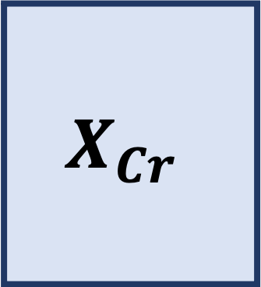
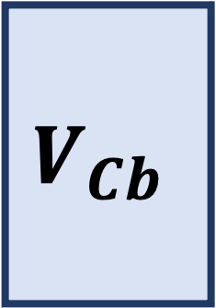





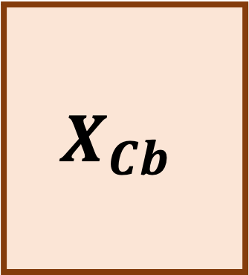

Y
Y
Original Image
Color Space Transform
Chroma subsampling
Patchify
Cb
Cr
Cb
Cr
Flatten and Stack Patches
Components
Encoded Image
$$U_{Y}$$
T
$$X_{Y}$$
0
1
0
0
1
.
.
.
$$U_{Cb}$$
$$X_{Cr}$$
T
$$V_{Cb}$$
Lossless Image Compression
Reshape Factors
$$V_{Y}$$
Integer Matrix Factorization
Coefficients
T
$$X_{Cb}$$
$$U_{Cr}$$
$$V_{Cr}$$

